Slide 1
TRANSFERS
Transferring Data to Central Office
Supervisor (receiver/Sender) >> CSWeb >> Central Office (Sender/receiver )

Slide 2
Data Transfer
What?
Why?
When?
Who?
How?
Submitting data to the Central Office
Back up and the Central Office can see the team’s progress
At least once per day
Supervisors
Internet

Slide 3
Fieldwork Flow
Arrive in cluster, Identify households
Interviewers carry out women interviews, enter biomarker data
Supervisor assigns households to interviewers
Interviewers send data to supervisor
Interviewers interview HHs, identify eligible individuals
Team resolves structural problems
Supervisor submits data to central office
Lab scientists collect blood for malaria/anemia
Notes:
Even though this is at the end of the fieldwork flow, we encourage supervisors to send the data on a daily basis. Acts like a back up in case something happens overnight (tablet gets stolen or broken).

Slide 4



Steps in Submitting Data
Supervisor connects to the internet
Supervisor chooses the option from the menu
The supervisor pays attention that the data is actually sent

Slide 5
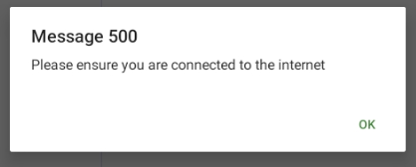
Connecting to the internet
THIS NEEDS TO BE DETERMINED HOW THE SUPERVISORS WILL CONNECT TO THE INTERNET
Notes:
This message will always pop up.

Slide 6
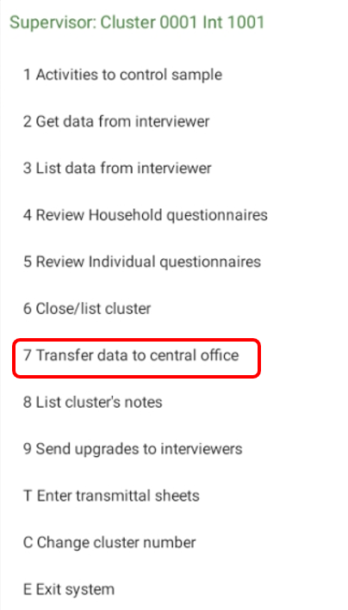
Supervisor Main Menu

Slide 7
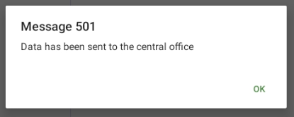
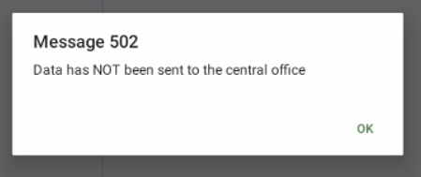
Confirmation that data was sent
GOOD JOB!!
Please try again ☺

Slide 8
Data Transfer
DEMONSTRATION

Slide 9
Data Transfer
EXPERIENCES FROM KNBS

Slide 10
Data Transfer
Q/A

